Slide 1



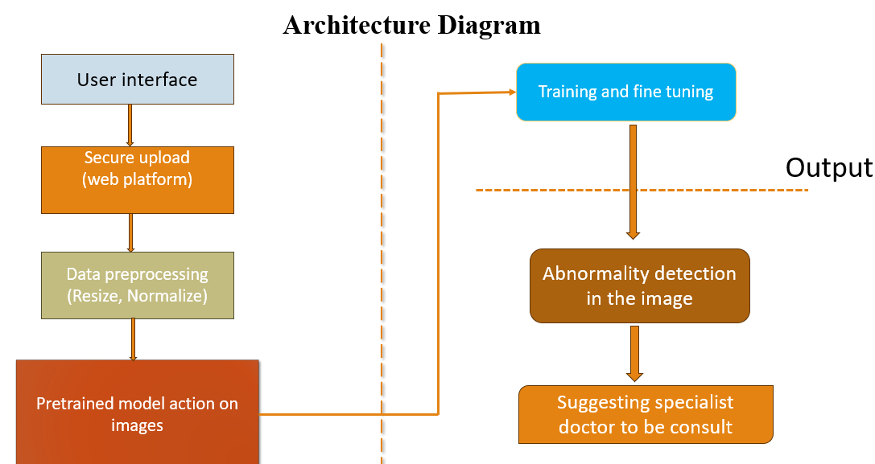
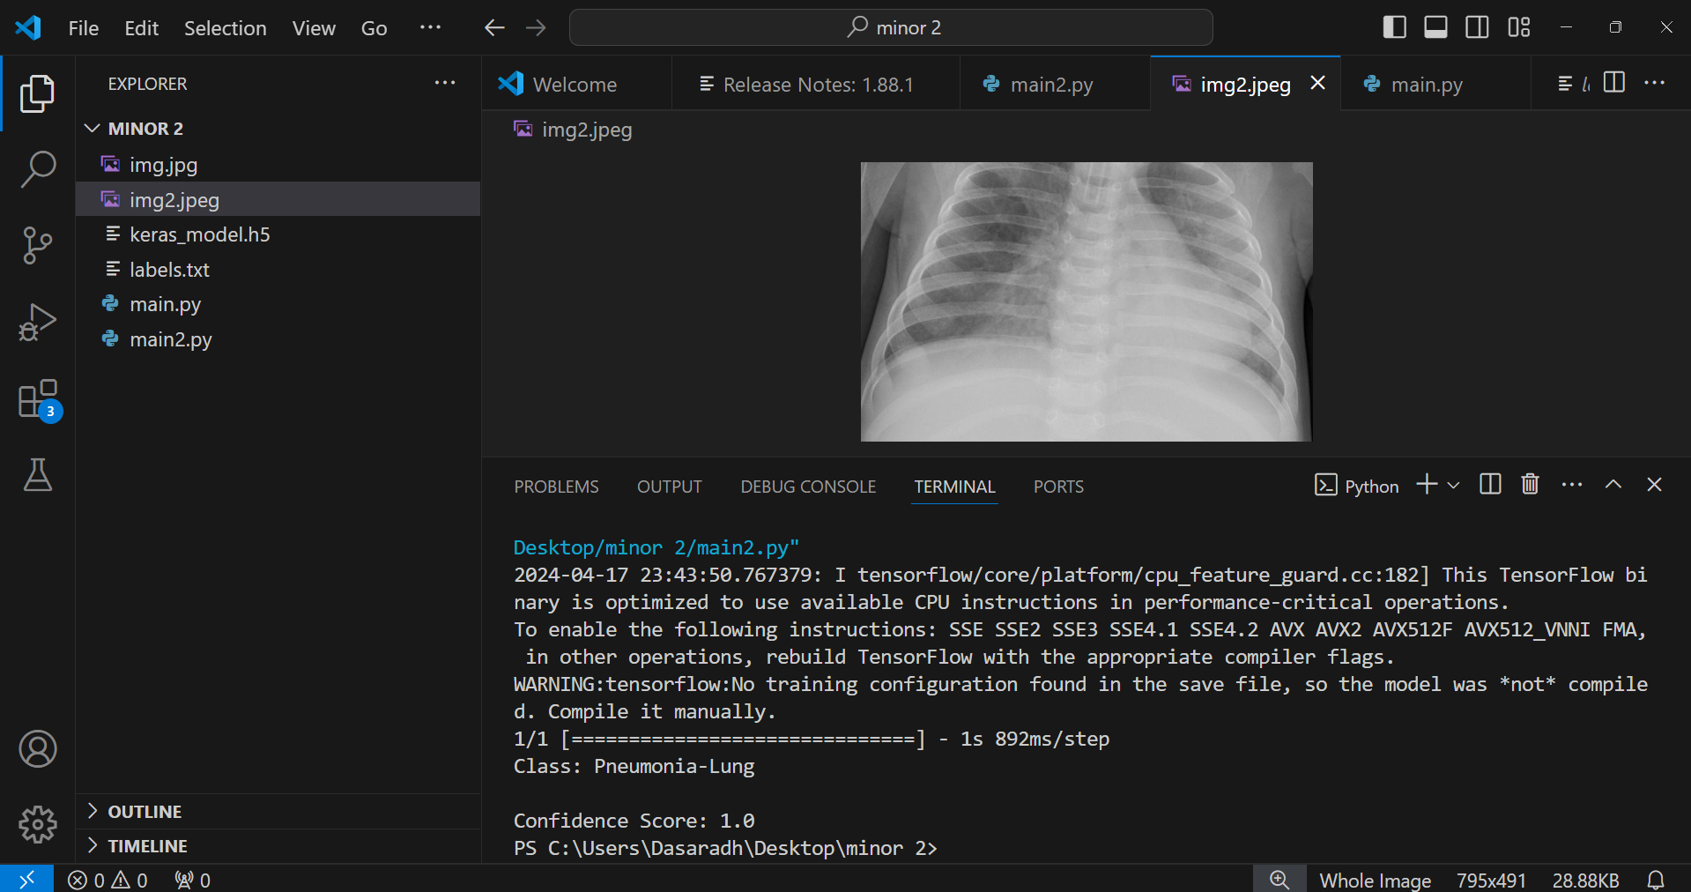
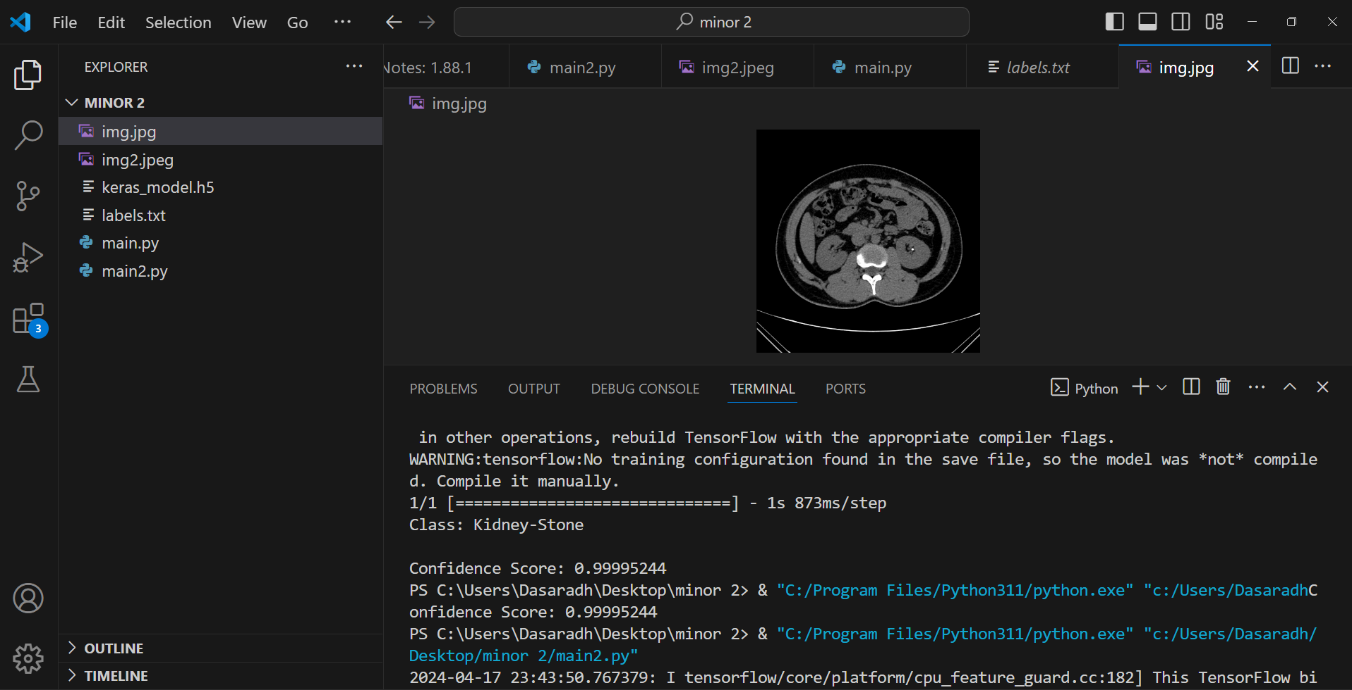
MEDI CLASSIFY: AI POWERED MEDICAL IMAGE DIAGNOSIS
Department of Computer Science & Engineering
School of Computing
10214CS602– MINOR PROJECT-II
WINTER SEMESTER 2023-2024
ABSTRACT
INTRODUCTION
METHODOLOGIES
RESULTS
Our project aims to develop an innovative deep learning-based system for automated medical image classification, focusing on fractures, kidney stones, and pneumonia. Leveraging convolutional neural networks (CNNs) and a user-friendly web interface, our system enables seamless image analysis and diagnosis, enhancing accessibility for healthcare providers and patients. Through meticulous data collection and model training, our system demonstrates promising performance in accurately identifying medical conditions, with potential implications for early disease detection and patient management.
Our project focuses on the development of an innovative system for automated medical image classification, aimed at assisting healthcare professionals in timely diagnosis and treatment planning. Leveraging state-of-the-art deep learning techniques, our system analyzes radiological images to classify three major diagnostic categories: fractures, kidney stones, and pneumonia. By harnessing the power of convolutional neural networks (CNNs) and integrating them into a user-friendly web interface, we aim to enhance accessibility and streamline the diagnostic process. Through meticulous data collection, preprocessing, and model training, our project endeavors to provide accurate and efficient medical image analysis, ultimately contributing to improved patient care and outcomes.
Data Collection and Preprocessing: We collect a diverse dataset of medical images, including fractures, kidney stones, and pneumonia cases. The images are meticulously preprocessed to ensure
Model Architecture Design: We design a convolutional neural network (CNN) architecture tailored to the task of medical image classification. The architecture consists of multiple layers for feature extraction and classification.
Model Training and Evaluation: The CNN model is trained on the preprocessed dataset using standard deep learning techniques. We split the dataset into training and validation sets to assess model performance. Various evaluation metrics are employed to measure the model's accuracy and generalization capability.
Integration into Web Interface: Once the model is trained and evaluated, we integrate it into a user-friendly web interface. It provides a good user interface through web platform
Our project successfully developed a deep learning-based system for automated medical image classification, focusing on fractures, kidney stones, and pneumonia. Leveraging convolutional neural networks (CNNs) and a diverse dataset of radiological images, our system demonstrated promising performance in accurately identifying medical conditions. Through meticulous data collection, preprocessing, and model training, we achieved high accuracy rates in classification tasks, empowering healthcare professionals with efficient tools for early disease detection and patient management.
CONCLUSIONS
In this project, we successfully developed a deep learning-based system for automated medical image classification, focusing on fractures, kidney stones, and pneumonia. Through meticulous data collection, preprocessing, and model training, our system demonstrates promising performance in accurately identifying medical conditions from radiological images. The integration of the model into a user-friendly web interface enhances accessibility for healthcare providers and patients, facilitating timely diagnosis and treatment planning. Our work lays a solid foundation for future advancements in automated medical diagnosis systems, with the potential to improve patient outcomes and revolutionize healthcare delivery.
ARCHITECTURE DIAGRAM
INPUT AND OUTPUT
TEAM MEMBER DETAILS
<Student 1. Vtu 19246/R. Dasaradh>
<Student 2 .Vtu19455/A. Navya Sri>
<Student 3 .Vtu 20520/S, Gowthami>
<Student 1. 9391338189>
<Student 2. 7842109337>
<Student 3. 8008846901>
<Student 1. vtu19246@veltech.edu.in>
<Student 2. vtu19455@veltech.edu.in>
<Student 3. vtu20520@veltech.edu.in>
ACKNOWLEDGEMENT
MS. S. HANNAH, ME, Assistant Professor
Ph No: 9941160706

